Slide 1
MOVIE TICKET BOOKING SYSTEM
DONE BY,
PRADEEP. J (710721106079)
SIDDARTH. K (710721106106)

Slide 2
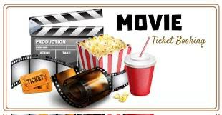

Slide 3
ABSTRACT:
The aim of the project is to provide information of the Movie Ticket Booking System to a customer to book the tickets. The project has been developed to carry out process easily and quickly. The system enables the user to Book tickets, Cancel tickets, View all booking records. The main goal of our project is to provide various types of customer facilities, and provide good customer service. The features are,
Booking tickets
Cancel tickets
Change ticket price(only admin)
View all booking records.

Slide 4
INTRODUCTION:
In this presentation, we will introduce a movie ticket booking system implemented in the C programming language. The system allows users to browse movies, select showtimes, and book tickets seamlessly. It aims to provide a user-friendly and efficient platform for moviegoers to reserve seats. Movie Ticket Booking System provides the customers facility to book tickets for a movie and to gather information about the movies and theaters.

Slide 5
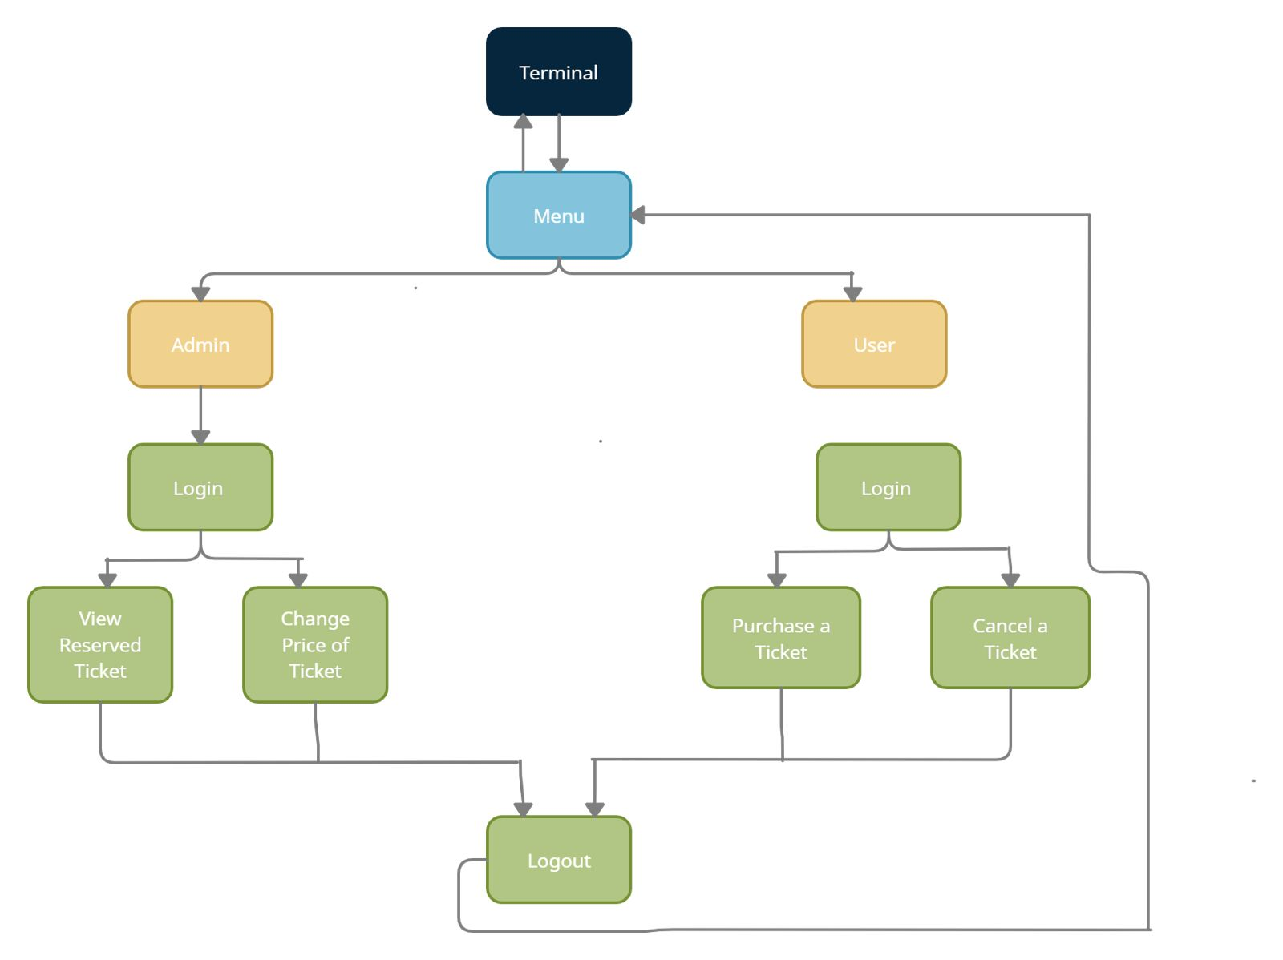
FLOWCHART:

Slide 6
DESIGN AND IMPLEMENTATION:
User Requirements:
Gathering and analyzing the requirements for the ticket booking system, including functions such as movie selection, seat reservation, and payment processing.
System Architecture:
Designing the structure of the system, including modules for database management, user interface, and integration with payment gateways.
Coding and Testing:
Implementing the system in C, performing rigorous testing to ensure accuracy, reliability, and security of the ticket booking process.

Slide 7
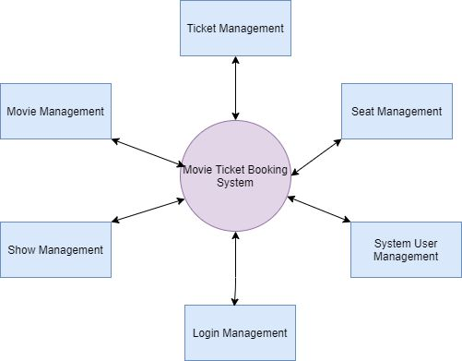
MOVIE TICKET BOOKING SYSTEM MANAGEMENT:

Slide 8
BENEFITS AND STRENGTHS:
The benefits are,
Provides flexibility
For better performance
User Friendly
Can Select the seats as per choice
The strengths are,
Increases efficiency
Reduces manual work
Global expansion
Simple and convenient to use

Slide 9
CONCLUSION:
In conclusion, the movie ticket booking system mini-project successfully addresses the challenges associated with traditional ticket booking methods. By leveraging technology, the system enhances user experience, ensures security, and provides efficient management tools for administrators. Through the development of this system, we aimed to provide a user-friendly and efficient platform for both customers and administrators.

Slide 10


